Slide 1

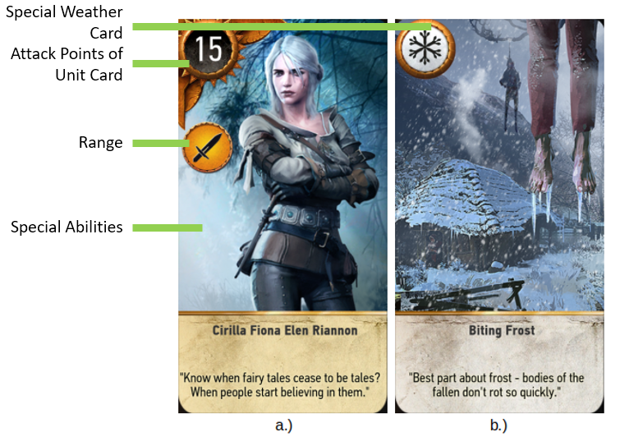
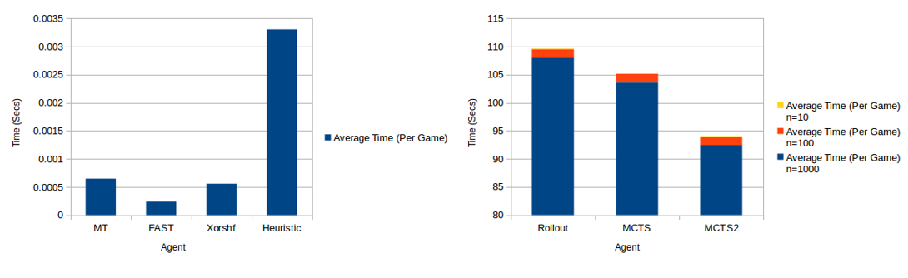
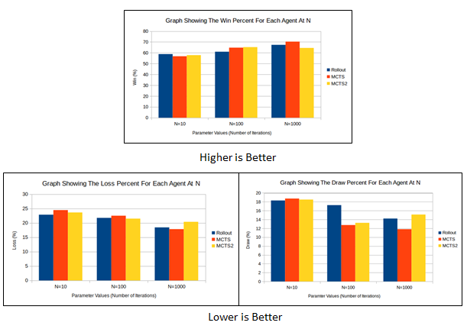
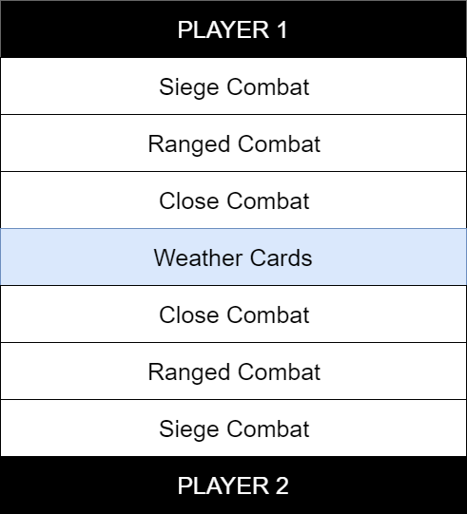
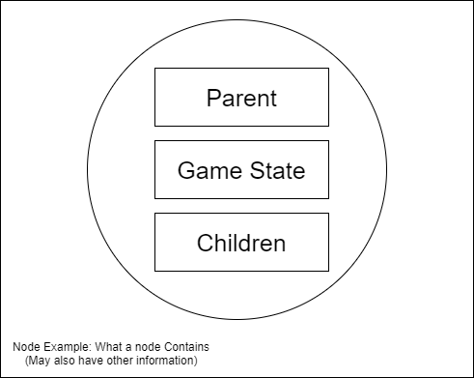
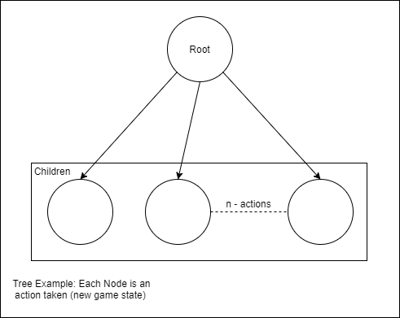
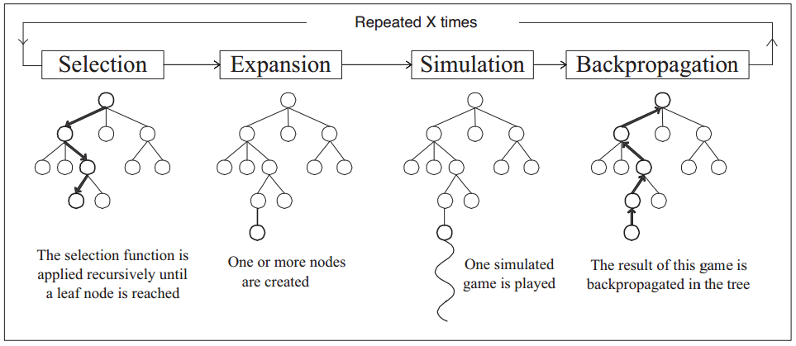
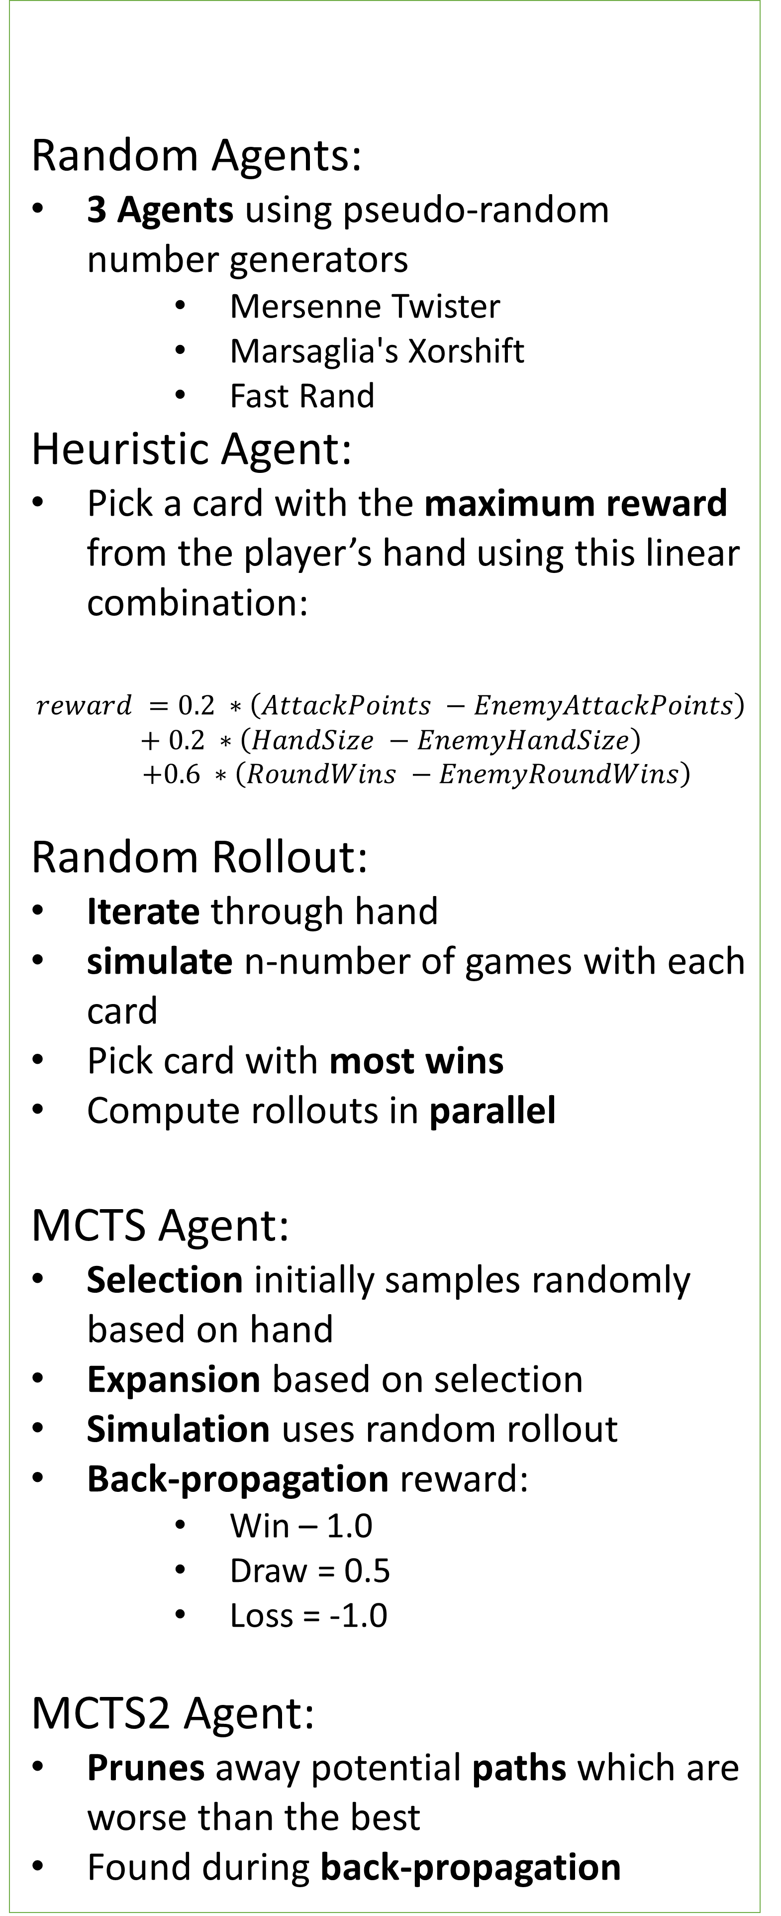
An Investigation of AI Tree Search Methods and Their Effectiveness
at Playing the Card Game Gwent
Jason Chalom (711985)¹
Supervisor: Professor Clint Van Alten¹
¹University of the Witwatersrand, South Africa
Objectives
Simulate the Game of Gwent
Build AI Agents for Gwent
Empirically Compare AI agents
If Possible Optimize Agents Using Parallel Programming
Method:
AIs are pitted against each other in a round-robin style tournament
Each “game” is run twice with the players and decks swapped (for x – runs)
Agent Times:
Agents VS Random (Over all random Agents):
Table of Agents VS Random: Table of Agents VS Agents:
Gwent
Rules (Excluding deck building) [2]:
Monte-Carlo Tree Search (MCTS) [3]
Uses game-state trees
Has 4 phases (Adapted from references [3])
Results
Background
Random Agents:
3 Agents using pseudo-random number generators
Mersenne Twister
Marsaglia's Xorshift
Fast Rand
Heuristic Agent:
Pick a card with the maximum reward from the player’s hand using this linear combination:
$$reward =0.2 ∗\left(AttackPoints −EnemyAttackPoints\right)$$
$$+ 0.2 ∗\left(HandSize −EnemyHandSize\right)$$
$$+0.6 ∗\left(RoundWins −EnemyRoundWins\right)$$
Random Rollout:
Iterate through hand
simulate n-number of games with each card
Pick card with most wins
Compute rollouts in parallel
MCTS Agent:
Selection initially samples randomly based on hand
Expansion based on selection
Simulation uses random rollout
Back-propagation reward:
Win – 1.0
Draw = 0.5
Loss = -1.0
MCTS2 Agent:
Prunes away potential paths which are worse than the best
Found during back-propagation
Implementation
2 Player turn-based
Best of three rounds
Players can pass a round
Only draw 10 random cards before 1st round
Units are placed in specific rows
Round wins calculated from total attack points
Motivation
Artificial Intelligence (AI):
Not all games are the same [1]
Games can be difficult for AI to solve in reasonable time [1]
The use of data structures and sampling techniques to model games.
The Domain (Gwent):
Special Cards | Abilities
Weather - Reduce attack points to 1 (for each card in a specific row) | Spy – add to opponent side but draw 3 new cards into hand
Commander’s Horn – doubles attack points of row | Medic – revive discarded unit cards
Hero – a special unit which is not affected by other special cards | Tight bond – multiplies sibling card attack points by number of cards on board
Agent | N=10 (secs) | N=100 (secs) | N=1000 (secs)
Rollout | 0.111459 | 1.47849 | 108.0554215
MCTS | 0.092066 | 1.52643 | 103.5874541
MCTS2 | 0.089473 | 1.50069 | 92.45517475
New domain
Interesting rules
Hidden information (unknown hands) [2]
It’s a fun game
Agents (P1 vs P2) | P1 Wins (%) | P2 Wins (%) | Draws (%)
Heuristic vs MT | 31.82 | 34.22 | 33.96
Heuristic vs Fast Rand | 99.34 | 0.48 | 0.18
Heuristic vs XorShift | 31.97 | 34.67 | 33.36
Rollout vs MT | 51.875 | 28.125 | 20
Rollout vs Fast Rand | 97.5 | 0 | 2.5
Rollout vs XorShift | 55 | 28.125 | 16.875
MCTS vs MT | 61.82 | 25.45 | 12.72
MCTS vs Fast Rand | 99.09 | 0 | 0.91
MCTS vs XorShift | 60.45 | 25 | 14.55
MCTS2 vs MT | 49.5 | 32 | 18.5
MCTS2 vs Fast Rand | 99 | 0 | 1
MCTS2 vs XorShift | 54 | 25 | 21
Agents (P1 vs P2) | N | P1 Wins(%) | P2 Wins(%) | Draws(%)
Heuristic vs Rollout | 10 | 33 | 36 | 31
Heuristic vs MCTS | 10 | 21 | 40 | 39
Heuristic vs MCTS2 | 10 | 26 | 42 | 32
Heuristic vs Rollout | 100 | 34 | 36 | 30
Heuristic vs Rollout | 1000 | 35 | 33 | 32
Heuristic vs MCTS | 100 | 28 | 54 | 18
Heuristic vs MCTS | 1000 | 16 | 63 | 21
Heuristic vs MCTS2 | 100 | 27 | 54 | 19
Rollout vs MCTS | 10 | 35 | 33 | 32
Rollout vs MCTS2 | 10 | 29 | 39 | 32
Rollout vs MCTS | 100 | 26 | 58 | 16
Rollout vs MCTS | 1000 | 26 | 51 | 23
Rollout vs MCTS2 | 100 | 16 | 64 | 20
MCTS vs MCTS2 | 10 | 46 | 40 | 14
MCTS vs MCTS2 | 100 | 51 | 39 | 10
Example game board [2]
Logic based agent
Hybrid MCTS (Mixture with Minimax algorithm)
More Complex Rules for Gwent
Machine learning and statistical sampling techniques
Future Work
[1] Stuart Russell and Peter Norvig. Artificial Intelligence: A Modern Approach (3rd Edition). Pearson, 2009.
[2] CD PROJEKT S.A., CD PROJEKT RED. GWENT Guide. pages 1–4. Poland, 2015.
[3] Chaslot, Guillaume and Bakkes, Sander and Szita, Istvan and Spronck, Pieter. Monte-Carlo Tree Search: A New Framework for Game AI. In Christian Darken and Michael Mateas, editors, AIIDE. The AAAI Press, 2008.
References

